Slide 1



|
‹#›
Thesis Defense
The Role of Emotion in the Success of Donation-Based Crowdfunding Campaigns: A Study of First Impressions and Emotional Appeal
Eleni Leonoglou
S5666015
Faculty of Economics and Business
MSc. Marketing Analytics and Data Science
Supervisor: Prof. dr. Jaap Wieringa
Second Supervisor: Prof. Maarten Gijsenberg

Slide 2

TABLE OF CONTENTS
01
INTRODUCTION
02
LITERATURE REVIEW
03
METHODOLOGY
04
RESULTS
05
DISCUSSION
06
CONCLUSIONS, RECOMMENDATIONS, & FUTURE RESEARCH
Eleni Leonoglou | MSc MADS | 2023 - 2024 | University of Groningen

Slide 3
01
INTRODUCTION

Slide 4
CROWDFUNDING PLATFORMS ARE TRANSFORMING FUNDRAISING.
Crowdfunding success relies on grabbing attention quickly. First impressions, heavily influenced by emotions, play a crucial role (Asch, 1946). This research explores how emotions in titles and cover images impact initial donation decision, ultimately affecting campaign success.
Eleni Leonoglou | MSc MADS | 2023 - 2024 | University of Groningen

Slide 5



WHAT IS THE PROBLEM / CHALLENGE?
Crowdfunding campaigns struggle to grab initial donor attention, hindering success. Emotions influence donations, but their effectiveness in titles & cover images is unclear.
WHAT ARE THE OBJECTIVES?
The goal is to investigate the effect of emotional valence in the initial decision-making stage, as well as analyze the combined effect of emotions in visual and verbal modalities.
HOW WE ARE GOING TO CONDUCT RESEARCH?
We analyze 148 campaigns to see how emotional appeal(positive/negative) in titles & images relates to donations. This reveals how emotions impact initial donor intention.
Eleni Leonoglou | MSc MADS | 2023 - 2024 | University of Groningen

Slide 6
“How do positive vs. negative emotions in titles & images affect initial donation decisions?”
Eleni Leonoglou | MSc MADS | 2023 - 2024 | University of Groningen

Slide 7
02
LITERATURE REVIEW

Slide 8
CONTRASTING THEORIES
Negative Appeal | Negative Appeal | Positive Appeal | Positive Appeal
Negative emotions are more effective in elicitng donations (Chang & Lee, 2010; Erlandsson et al., 2018; Small & Verrochi, 2009) Evokes sympathy (Baberini et al., 2015; Small & Verrochi, 2009) and empathy (Bagozzi & Moore, 1994; Vitaglione & Barnett, 2003), leading to donations. Negative emotions in ads can create a desire to fix one's negtive mood by donating (Batson & et al, 1981; Erlandsson et al., 2018; RB et al., 1987). Negative appeal can be powerful, but using it strategically is crucial (Lwin & Phau, 2014). | Negative emotions are more effective in elicitng donations (Chang & Lee, 2010; Erlandsson et al., 2018; Small & Verrochi, 2009) Evokes sympathy (Baberini et al., 2015; Small & Verrochi, 2009) and empathy (Bagozzi & Moore, 1994; Vitaglione & Barnett, 2003), leading to donations. Negative emotions in ads can create a desire to fix one's negtive mood by donating (Batson & et al, 1981; Erlandsson et al., 2018; RB et al., 1987). Negative appeal can be powerful, but using it strategically is crucial (Lwin & Phau, 2014). | Positive emotions can motivate pro-social behavior, including donating behavior (Li & Atkinson, 2020; Zemack-Rugar & Klucarova-Travani, 2018). Individuals may donate to escape negative emotions and create positive ones (warm glow) (Bagozzi, 2006; Brown et al., 1997); Schaller & Cialdini; 1988). Pure altruism motivations can encourage donations. (Gleasure & Feller, 2016). Overly positive appeals that promote the benefits for the viewers can actually decrease donations (Carvalho et al., 2019; Fisher et al., 2008; Fisher & Ma, 2014; Liang et al., 2016) | Positive emotions can motivate pro-social behavior, including donating behavior (Li & Atkinson, 2020; Zemack-Rugar & Klucarova-Travani, 2018). Individuals may donate to escape negative emotions and create positive ones (warm glow) (Bagozzi, 2006; Brown et al., 1997); Schaller & Cialdini; 1988). Pure altruism motivations can encourage donations. (Gleasure & Feller, 2016). Overly positive appeals that promote the benefits for the viewers can actually decrease donations (Carvalho et al., 2019; Fisher et al., 2008; Fisher & Ma, 2014; Liang et al., 2016)
Negative emotions are more effective in elicitng donations (Chang & Lee, 2010; Erlandsson et al., 2018; Small & Verrochi, 2009) Evokes sympathy (Baberini et al., 2015; Small & Verrochi, 2009) and empathy (Bagozzi & Moore, 1994; Vitaglione & Barnett, 2003), leading to donations. Negative emotions in ads can create a desire to fix one's negtive mood by donating (Batson & et al, 1981; Erlandsson et al., 2018; RB et al., 1987). Negative appeal can be powerful, but using it strategically is crucial (Lwin & Phau, 2014). | Negative emotions are more effective in elicitng donations (Chang & Lee, 2010; Erlandsson et al., 2018; Small & Verrochi, 2009) Evokes sympathy (Baberini et al., 2015; Small & Verrochi, 2009) and empathy (Bagozzi & Moore, 1994; Vitaglione & Barnett, 2003), leading to donations. Negative emotions in ads can create a desire to fix one's negtive mood by donating (Batson & et al, 1981; Erlandsson et al., 2018; RB et al., 1987). Negative appeal can be powerful, but using it strategically is crucial (Lwin & Phau, 2014). | Positive emotions can motivate pro-social behavior, including donating behavior (Li & Atkinson, 2020; Zemack-Rugar & Klucarova-Travani, 2018). Individuals may donate to escape negative emotions and create positive ones (warm glow) (Bagozzi, 2006; Brown et al., 1997); Schaller & Cialdini; 1988). Pure altruism motivations can encourage donations. (Gleasure & Feller, 2016). Overly positive appeals that promote the benefits for the viewers can actually decrease donations (Carvalho et al., 2019; Fisher et al., 2008; Fisher & Ma, 2014; Liang et al., 2016) | Positive emotions can motivate pro-social behavior, including donating behavior (Li & Atkinson, 2020; Zemack-Rugar & Klucarova-Travani, 2018). Individuals may donate to escape negative emotions and create positive ones (warm glow) (Bagozzi, 2006; Brown et al., 1997); Schaller & Cialdini; 1988). Pure altruism motivations can encourage donations. (Gleasure & Feller, 2016). Overly positive appeals that promote the benefits for the viewers can actually decrease donations (Carvalho et al., 2019; Fisher et al., 2008; Fisher & Ma, 2014; Liang et al., 2016)
Negative emotions are more effective in elicitng donations (Chang & Lee, 2010; Erlandsson et al., 2018; Small & Verrochi, 2009) Evokes sympathy (Baberini et al., 2015; Small & Verrochi, 2009) and empathy (Bagozzi & Moore, 1994; Vitaglione & Barnett, 2003), leading to donations. Negative emotions in ads can create a desire to fix one's negtive mood by donating (Batson & et al, 1981; Erlandsson et al., 2018; RB et al., 1987). Negative appeal can be powerful, but using it strategically is crucial (Lwin & Phau, 2014). | Negative emotions are more effective in elicitng donations (Chang & Lee, 2010; Erlandsson et al., 2018; Small & Verrochi, 2009) Evokes sympathy (Baberini et al., 2015; Small & Verrochi, 2009) and empathy (Bagozzi & Moore, 1994; Vitaglione & Barnett, 2003), leading to donations. Negative emotions in ads can create a desire to fix one's negtive mood by donating (Batson & et al, 1981; Erlandsson et al., 2018; RB et al., 1987). Negative appeal can be powerful, but using it strategically is crucial (Lwin & Phau, 2014). | Positive emotions can motivate pro-social behavior, including donating behavior (Li & Atkinson, 2020; Zemack-Rugar & Klucarova-Travani, 2018). Individuals may donate to escape negative emotions and create positive ones (warm glow) (Bagozzi, 2006; Brown et al., 1997); Schaller & Cialdini; 1988). Pure altruism motivations can encourage donations. (Gleasure & Feller, 2016). Overly positive appeals that promote the benefits for the viewers can actually decrease donations (Carvalho et al., 2019; Fisher et al., 2008; Fisher & Ma, 2014; Liang et al., 2016) | Positive emotions can motivate pro-social behavior, including donating behavior (Li & Atkinson, 2020; Zemack-Rugar & Klucarova-Travani, 2018). Individuals may donate to escape negative emotions and create positive ones (warm glow) (Bagozzi, 2006; Brown et al., 1997); Schaller & Cialdini; 1988). Pure altruism motivations can encourage donations. (Gleasure & Feller, 2016). Overly positive appeals that promote the benefits for the viewers can actually decrease donations (Carvalho et al., 2019; Fisher et al., 2008; Fisher & Ma, 2014; Liang et al., 2016)
Negative emotions are more effective in elicitng donations (Chang & Lee, 2010; Erlandsson et al., 2018; Small & Verrochi, 2009) Evokes sympathy (Baberini et al., 2015; Small & Verrochi, 2009) and empathy (Bagozzi & Moore, 1994; Vitaglione & Barnett, 2003), leading to donations. Negative emotions in ads can create a desire to fix one's negtive mood by donating (Batson & et al, 1981; Erlandsson et al., 2018; RB et al., 1987). Negative appeal can be powerful, but using it strategically is crucial (Lwin & Phau, 2014). | Negative emotions are more effective in elicitng donations (Chang & Lee, 2010; Erlandsson et al., 2018; Small & Verrochi, 2009) Evokes sympathy (Baberini et al., 2015; Small & Verrochi, 2009) and empathy (Bagozzi & Moore, 1994; Vitaglione & Barnett, 2003), leading to donations. Negative emotions in ads can create a desire to fix one's negtive mood by donating (Batson & et al, 1981; Erlandsson et al., 2018; RB et al., 1987). Negative appeal can be powerful, but using it strategically is crucial (Lwin & Phau, 2014). | Positive emotions can motivate pro-social behavior, including donating behavior (Li & Atkinson, 2020; Zemack-Rugar & Klucarova-Travani, 2018). Individuals may donate to escape negative emotions and create positive ones (warm glow) (Bagozzi, 2006; Brown et al., 1997); Schaller & Cialdini; 1988). Pure altruism motivations can encourage donations. (Gleasure & Feller, 2016). Overly positive appeals that promote the benefits for the viewers can actually decrease donations (Carvalho et al., 2019; Fisher et al., 2008; Fisher & Ma, 2014; Liang et al., 2016) | Positive emotions can motivate pro-social behavior, including donating behavior (Li & Atkinson, 2020; Zemack-Rugar & Klucarova-Travani, 2018). Individuals may donate to escape negative emotions and create positive ones (warm glow) (Bagozzi, 2006; Brown et al., 1997); Schaller & Cialdini; 1988). Pure altruism motivations can encourage donations. (Gleasure & Feller, 2016). Overly positive appeals that promote the benefits for the viewers can actually decrease donations (Carvalho et al., 2019; Fisher et al., 2008; Fisher & Ma, 2014; Liang et al., 2016)
Negative emotions are more effective in elicitng donations (Chang & Lee, 2010; Erlandsson et al., 2018; Small & Verrochi, 2009) Evokes sympathy (Baberini et al., 2015; Small & Verrochi, 2009) and empathy (Bagozzi & Moore, 1994; Vitaglione & Barnett, 2003), leading to donations. Negative emotions in ads can create a desire to fix one's negtive mood by donating (Batson & et al, 1981; Erlandsson et al., 2018; RB et al., 1987). Negative appeal can be powerful, but using it strategically is crucial (Lwin & Phau, 2014). | Negative emotions are more effective in elicitng donations (Chang & Lee, 2010; Erlandsson et al., 2018; Small & Verrochi, 2009) Evokes sympathy (Baberini et al., 2015; Small & Verrochi, 2009) and empathy (Bagozzi & Moore, 1994; Vitaglione & Barnett, 2003), leading to donations. Negative emotions in ads can create a desire to fix one's negtive mood by donating (Batson & et al, 1981; Erlandsson et al., 2018; RB et al., 1987). Negative appeal can be powerful, but using it strategically is crucial (Lwin & Phau, 2014). | Positive emotions can motivate pro-social behavior, including donating behavior (Li & Atkinson, 2020; Zemack-Rugar & Klucarova-Travani, 2018). Individuals may donate to escape negative emotions and create positive ones (warm glow) (Bagozzi, 2006; Brown et al., 1997); Schaller & Cialdini; 1988). Pure altruism motivations can encourage donations. (Gleasure & Feller, 2016). Overly positive appeals that promote the benefits for the viewers can actually decrease donations (Carvalho et al., 2019; Fisher et al., 2008; Fisher & Ma, 2014; Liang et al., 2016) | Positive emotions can motivate pro-social behavior, including donating behavior (Li & Atkinson, 2020; Zemack-Rugar & Klucarova-Travani, 2018). Individuals may donate to escape negative emotions and create positive ones (warm glow) (Bagozzi, 2006; Brown et al., 1997); Schaller & Cialdini; 1988). Pure altruism motivations can encourage donations. (Gleasure & Feller, 2016). Overly positive appeals that promote the benefits for the viewers can actually decrease donations (Carvalho et al., 2019; Fisher et al., 2008; Fisher & Ma, 2014; Liang et al., 2016)
Eleni Leonoglou | MSc MADS | 2023 - 2024 | University of Groningen

Slide 9
ANOTHER ASPECT: CONGRUENCY
Emotional Congruency
Coherence of the emotional cues communicated by textual and visual content.
Pros:
Makes semantic concepts more accessible¹ and improve information processing².
Cognitive dissonance theory (Festinger, 1997) and balance theory (Horney, 2013) support that incogruent messages create feelings of discomfort.
Enhances the persuasiveness of charity campaign appeals (Zhao et al., 2022), especially in a negative context (Chang & Lee, 2009).
However...
in some cases, emotional congruency does not benefit the campaign (McIntyre et al., 2018; Liang et al.,2016)
¹ Bower, 1981; Niedenthal & Setterlund, 1994 ² Lochbuehler et al., 2018; van Rompay et al., 2010; Wang et al., 2019
Eleni Leonoglou | MSc MADS | 2023 - 2024 | University of Groningen

Slide 10
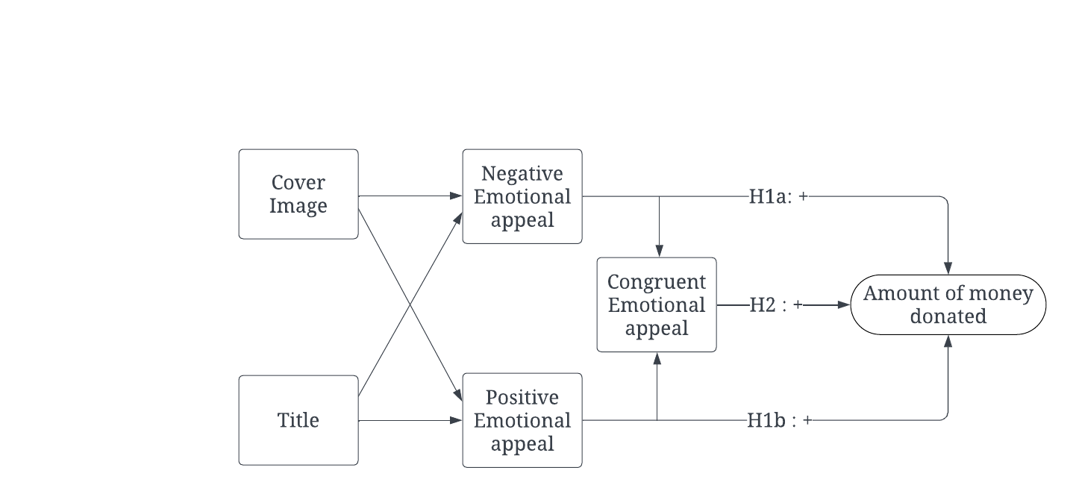
HYPOTHESES
H1a: Negative appeal in either cover images or titles has a positive effect have a positive effect on donors’ decisions in donation-based crowdfunding campaigns during the first stage of decision-making.
H1b: Positive appeal in either cover images or titles has a positive effect has a positive effect on donors’ decisions in donation-based crowdfunding campaigns during the first stage of decision-making
H2: Congruent emotions simultaneously expressed in cover images and titles of donation-based crowdfunding campaigns have a positive effect on donors’ decisions.
Eleni Leonoglou | MSc MADS | 2023 - 2024 | University of Groningen

Slide 11
03
METHODOLOGY

Slide 12
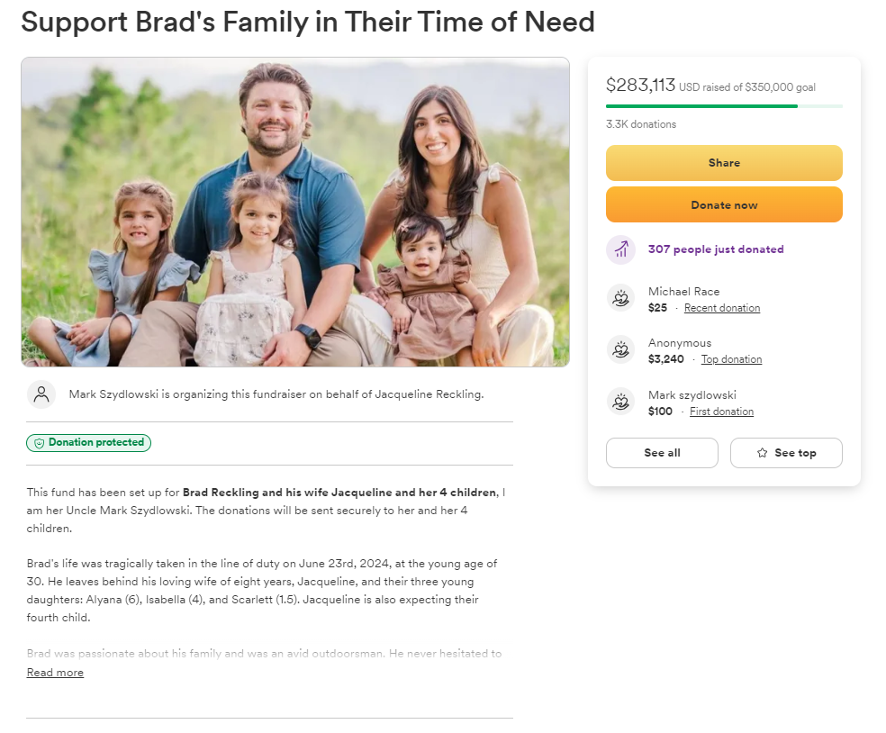
DATA COLLECTION
Web-scraped data from 148 campaigns on GoFundMe
Data from Feb 21st 2013 to Dec 4th 2020
Focus on English-language campaigns
Crawled variables:
titles,
cover images,
amount of money raised,
goal amount,
date of creation,
category type
Eleni Leonoglou | MSc MADS | 2023 - 2024 | University of Groningen

Slide 13

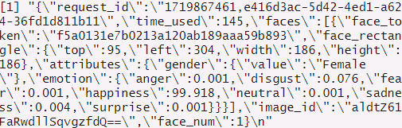
ANALYSIS & DEVELOPMENT
01
TEXT SENTIMENT
02
IMAGE SENTIMENT
Tokenization, stemming, stop-word removal
Sentimentr package used for scoring
Lexicon-based approach with value shifters
Face++ API utilized for emotion score extraction
Valence derived from individual emotions
Eleni Leonoglou | MSc MADS | 2023 - 2024 | University of Groningen

Slide 14
ANALYSIS & DEVELOPMENT
03
DATA CLEANSING
Removing duplicate or missing values, correcting inconsistencies.
Measuring emotional valence.
Combining data sources for analysis.
04
STATISTICAL ANALYSIS
Exploratory analysis: Understanding data distribution and trends.
Model estimation: Modeling relationships between variables.
Model validation: Ensuring model accuracy and generalizability.
Dependent: Amount raised($),
Independent: Emotional scores of text and image,
Control: Campaign-level attributes
Eleni Leonoglou | MSc MADS | 2023 - 2024 | University of Groningen

Slide 15
04
RESULTS

Slide 16
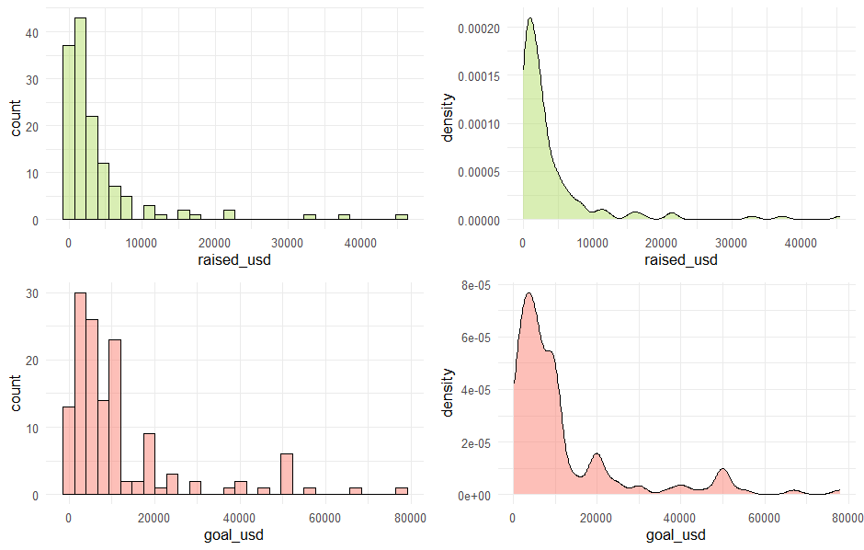
EXPLORATORY ANALYSIS
Observation 1:
The outcome variable and the control variables are skewed to the right.
Observation 2:
Only 15.2% of the campaigns achieved or surpassed their goal.
Eleni Leonoglou | MSc MADS | 2023 - 2024 | University of Groningen

Slide 17
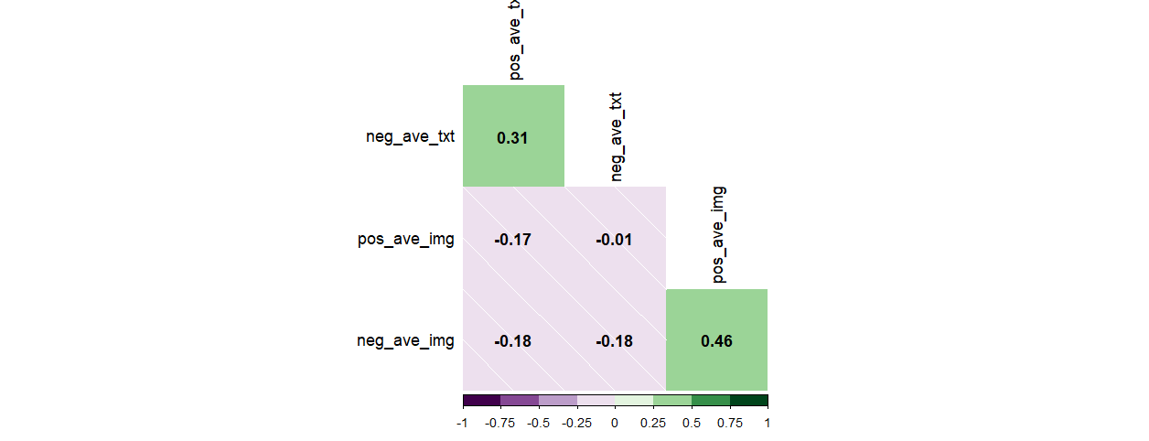
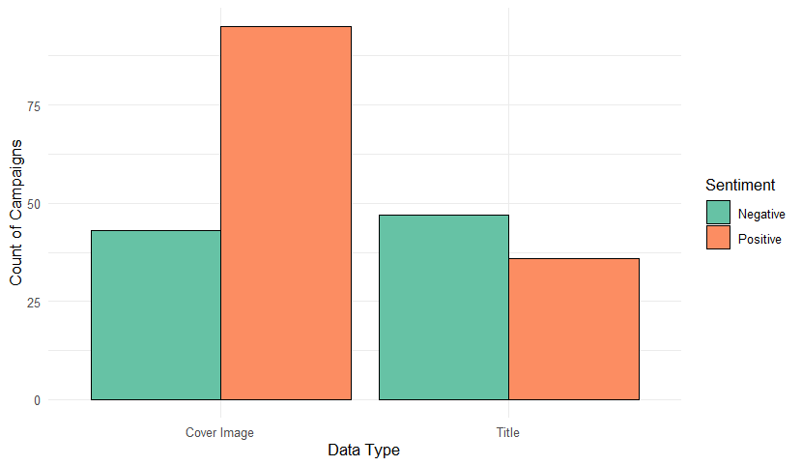
EXPLORATORY ANALYSIS
Observation 3:
Positive emotional appeal in images conquers over negative appeal in cover images, while emotional valence in text is more evenly distributed.
Observation 4
Emotional valence in text and images are not one-dimensional, rather they co-exist within the same modality.
Eleni Leonoglou | MSc MADS | 2023 - 2024 | University of Groningen

Slide 18
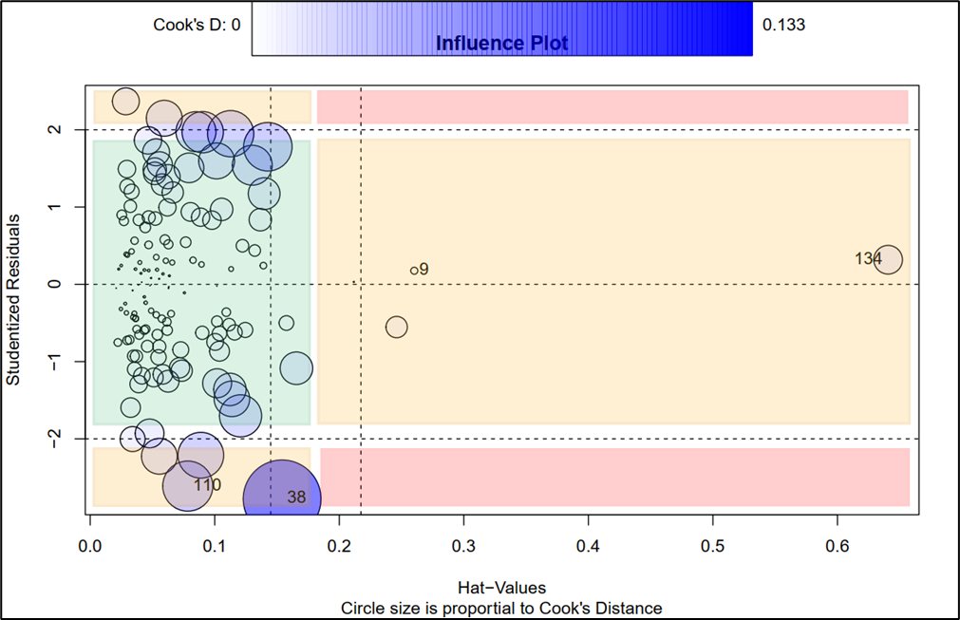
VALIDATION
Unusual Data Points
We examined unusual data points using studentized residuals, leverage, and Cook’s distance.
Most points with high Cook’s distance are neither outliers nor have high leverage. Those with high leverage are not outliers and vice versa. Therefore, the unusual data points do not impact our regression estimates.
Eleni Leonoglou | MSc MADS | 2023 - 2024 | University of Groningen

Slide 19
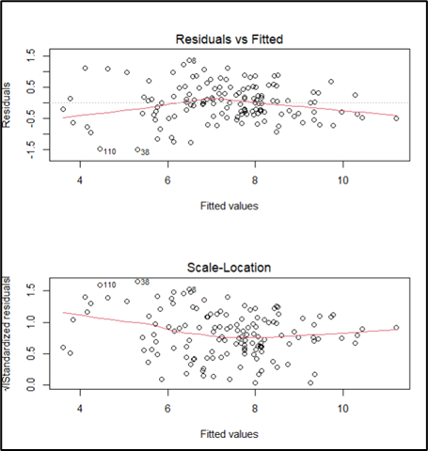
VALIDATION
Disturbance error assumptions
Tests Conducted:
Autocorrelation
Non-normality
3. Multicollinearity (VIFs ≤ 5)
4. Heteroscedasticity
Heteroscedasticity was detected in the residuals, detected visually and by a significant Breusch-Pagan Test.
Addressed Heteroscedasticity using Robust Standard Errors:
HC0, HC1, HC2, HC3 (Sandwich package). HC3 recommended for small samples.
Eleni Leonoglou | MSc MADS | 2023 - 2024 | University of Groningen

Slide 20
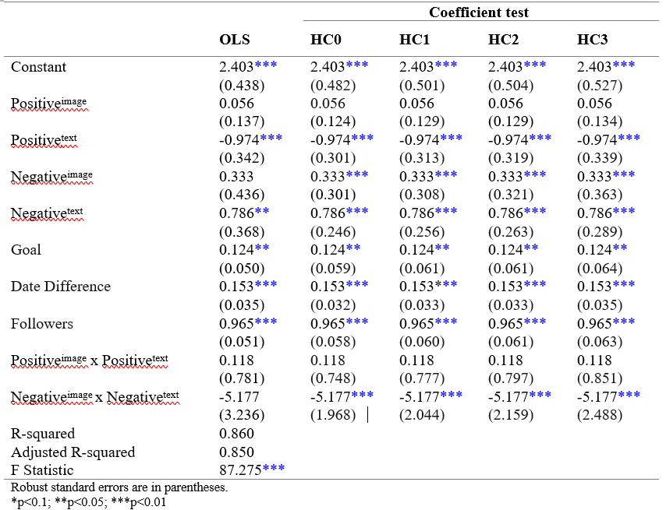
ESTIMATION
Positive text appeal is significantly negatively associated with donation amount.
Negative image appeal and negative text appeal is significantly positively associated with donation amount.
Control variables are significant predictors of donation amount.
A congruent negative appeal is significantly negatively associated with donation amount.
Eleni Leonoglou | MSc MADS | 2023 - 2024 | University of Groningen

Slide 21
05
DISCUSSION

Slide 22


DISCUSSION
H1a |  | Negative emotional appeals, whether in images or text, are effective separately, in a way that that they can possibly evoke empathy (Batson & et al, 1981; Erlandsson et al., 2018; RB et al., 1987) and sympathy (Baberini et al., 2015; Small & Verrochi, 2009) and prompt immediate responses from donors (Bagozzi & Moore, 1994; Chang & Lee, 2010; Vitaglione & Barnett, 2003).
H1b |  | Positive emotional appeals are universally ineffective (Cavanaugh et al., 2015; Fiala & Noussair, 2017; Genevsky & Knutson, 2015; Isen, 2001; Li & Atkinson, 2020; Zemack-Rugar & Klucarova-Travani, 2018). Contrary to some theories that suggest positive emotions foster a warm connection with the campaign (Gleasure & Feller, 2016), our results indicate that positive emotional appeals in text can actually deter donations. In images, emotional appeal seems to have no effect.
H2 |  | Combining negative emotional appeals across both modalities can deter donations. This opposes Zhao’s et al. (2022) results that a congruent emotional appeal leads to increased donations.
Eleni Leonoglou | MSc MADS | 2023 - 2024 | University of Groningen

Slide 23
06
CONCLUSIONS, RECOMMENDATIONS, & FUTURE RESEARCH

Slide 24
CONCLUSIONS
CONCLUSION 1
Emotional appeal in campaign titles and cover images significantly influences donor engagement and decision-making.
CONCLUSION 2
Negative emotional appeals are generally more effective than positive ones in attracting donations.
CONCLUSION 3
The combination of negative emotional congruence between titles and images negatively affects the overall effectiveness of crowdfunding campaigns
Eleni Leonoglou | MSc MADS | 2023 - 2024 | University of Groningen

Slide 25
IMPLICATIONS
ACADEMIC IMPLICATIONS
• These insights can be utilized to optimize crowdfunding campaigns, turning their attention to the initial decision-making stage.
• Designing more effective and persuasive crowdfunding campaigns, by ensuring that either campaign titles or cover images have negative emotional appeal, without overwhelming the modality with negativity.
• From the potential donor’s perspective, we make them aware to the power of emotion.
• Adds to the theory about emotional appeals in marketing.
• Focus on the multi-modal effects, highlighting the effect of emotional congruence.
• Provides insights into the first stage of decision making in crowdfunding.
• We provide additional evidence that supports the superiority of verbal over visual modality.
• Point out potential disadvantages of using congruent negative emotions excessively.
PRACTICAL IMPLICATIONS
Eleni Leonoglou | MSc MADS | 2023 - 2024 | University of Groningen

Slide 26
LIMITATIONS & FUTURE REASEARCH
LIMITATIONS
Compare campaigns across different countries and time zones.
Use advanced lexicons (LIWC, VADER) and state-of-the-art methods (machine learning, deep learning) for emotion extraction.
Isolate the drivers of initial decision making by looking into what drives the first decision to click the campaign.
Research on if and how particular emotional contents can affect CSR activities.
Study interactions between different types of content (informational, directive, affective) and message framing.
Study based on 148 campaigns, may not represent all donation-based crowdfunding campaigns.
Primarily focused on GoFundMe, limiting generalizability to other platforms
FUTURE RESEARCH
Eleni Leonoglou | MSc MADS | 2023 - 2024 | University of Groningen

Slide 27

‹#›
THANK YOU
Do you have any questions?

